Slide 1

Chapter 4 Selections

Slide 2
Motivations
If you assigned a negative value for radius in Listing 2.1, ComputeArea.py, the program would print an invalid result. If the radius is negative, you don't want the program to compute the area. How can you deal with this situation?

Slide 3
Objectives
To write Boolean expressions by using comparison operators (§4.2).
To generate random numbers by using the random.randint(a, b) or random.random() functions (§4.3).
To program with Boolean expressions (AdditionQuiz) (§4.3).
To implement selection control by using one-way if statements (§4.4)
To program with one-way if statements (GuessBirthday) (§4.5).
To implement selection control by using two-way if .. else statements (§4.6).
To implement selection control with nested if ... elif ... else statements (§4.7).
To avoid common errors in if statements (§4.8).
To program with selection statements (§4.9–4.10).
To combine conditions by using logical operators (and, or, and not) (§4.11).
To use selection statements with combined conditions (LeapYear, Lottery) (§§4.12–4.13).
To write expressions that use the conditional expressions (§4.14).
To understand the rules governing operator precedence and associativity (§4.15).

Slide 4
Boolean Data Types
Often in a program you need to compare two values, such as whether i is greater than j. There are six comparison operators (also known as relational operators) that can be used to compare two values. The result of the comparison is a Boolean value: true or false.
b = (1 > 2)

Slide 5
Comparison Operators
Operator Name
< less than
<= less than or equal to
> greater than
>= greater than or equal to
== equal to
!= not equal to

Slide 6
Problem: A Simple Math Learning Tool
This example creates a program to let a first grader practice additions. The program randomly generates two single-digit integers number1 and number2 and displays a question such as “What is 7 + 9?” to the student. After the student types the answer, the program displays a message to indicate whether the answer is true or false.
AdditionQuiz
Run

Slide 7
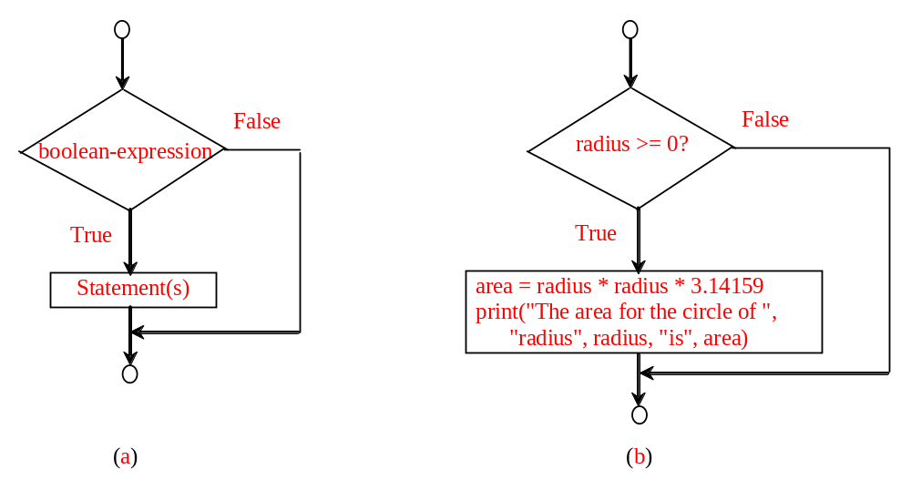
One-way if Statements
if radius >= 0:
area = radius * radius * 3.14159
print("The area for the circle of radius“,
radius, "is“, area)
if boolean-expression:
statement(s)

Slide 8
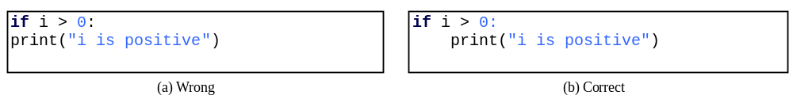
Note

Slide 9
Simple if Demo
Write a program that prompts the user to enter an integer. If the number is a multiple of 5, print HiFive. If the number is divisible by 2, print HiEven.
SimpleIfDemo
Run

Slide 10
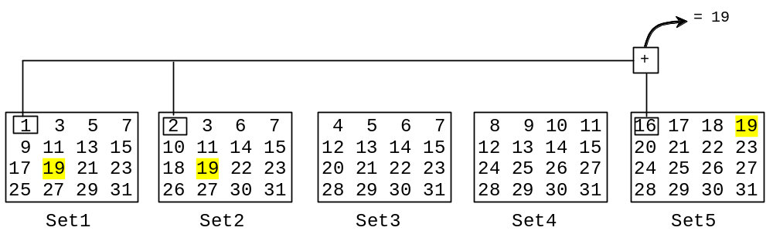

Problem: Guessing Birthday
The program can guess your birth date. Run to see how it works.
GuessBirthday

Slide 11
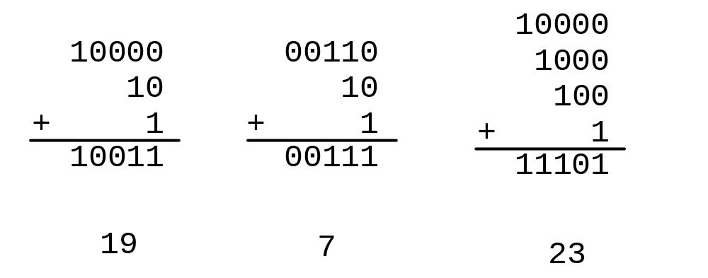
Mathematics Basis for the Game
19 is 10011 in binary. 7 is 111 in binary. 23 is 11101 in binary

Slide 12
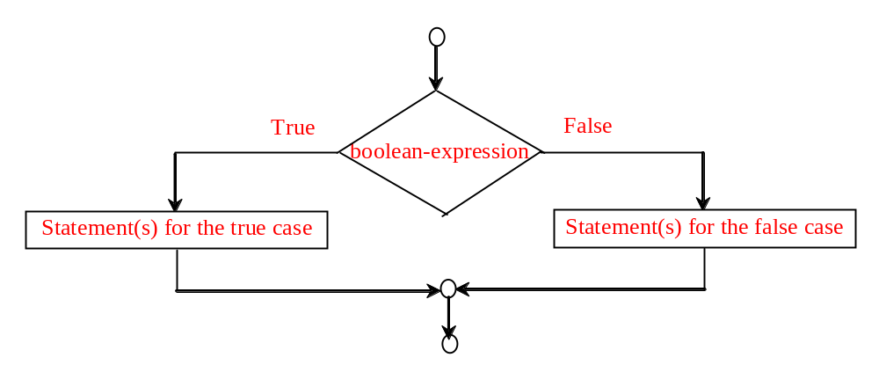
The Two-way if Statement
if boolean-expression:
statement(s)-for-the-true-case
else:
statement(s)-for-the-false-case

Slide 13
if...else Example
if radius >= 0:
area = radius * radius * math.pi
print("The area for the circle of radius", radius, "is", area)
else:
print("Negative input")

Slide 14
Problem: An Improved Math Learning Tool
This example creates a program to teach a first grade child how to learn subtractions. The program randomly generates two single-digit integers number1 and number2 with number1 > number2 and displays a question such as “What is 9 – 2?” to the student. After the student types the answer in the input dialog box, the program displays a message dialog box to indicate whether the answer is correct.
SubtractionQuiz

Slide 15
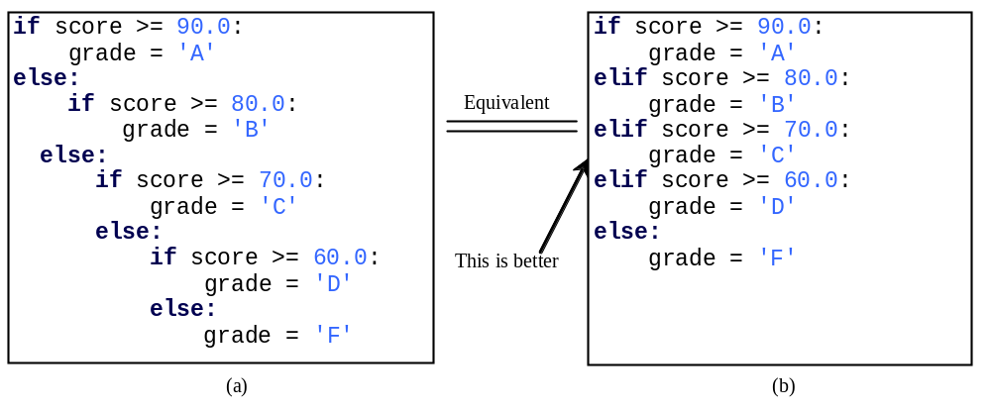
Multiple Alternative if Statements

Slide 16
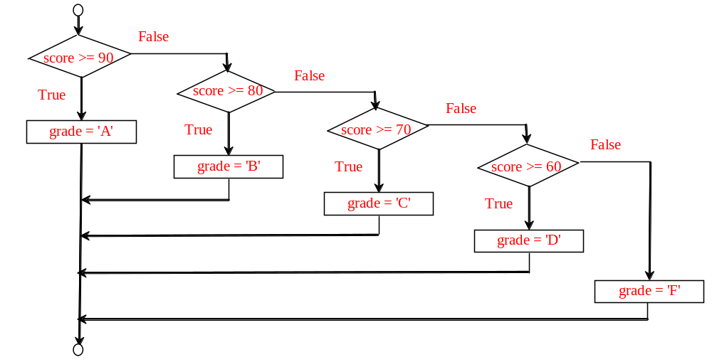
Flowchart

Slide 17
Trace if-else statement
animation
Suppose score is 70.0
The condition is false
if score >= 90.0:
grade = 'A'
elif score >= 80.0:
grade = 'B'
elif score >= 70.0:
grade = 'C'
elif score >= 60.0:
grade = 'D'
else:
grade = 'F'

Slide 18
Trace if-else statement
animation
Suppose score is 70.0
The condition is false
if score >= 90.0:
grade = 'A'
elif score >= 80.0:
grade = 'B'
elif score >= 70.0:
grade = 'C'
elif score >= 60.0:
grade = 'D'
else:
grade = 'F'

Slide 19
Trace if-else statement
animation
Suppose score is 70.0
The condition is true
if score >= 90.0:
grade = 'A'
elif score >= 80.0:
grade = 'B'
elif score >= 70.0:
grade = 'C'
elif score >= 60.0:
grade = 'D'
else:
grade = 'F'

Slide 20
Trace if-else statement
animation
Suppose score is 70.0
grade is C
if score >= 90.0:
grade = 'A'
elif score >= 80.0:
grade = 'B'
elif score >= 70.0:
grade = 'C'
elif score >= 60.0:
grade = 'D'
else:
grade = 'F'

Slide 21
Trace if-else statement
animation
Suppose score is 70.0
Exit the if statement
if score >= 90.0:
grade = 'A'
elif score >= 80.0:
grade = 'B'
elif score >= 70.0:
grade = 'C'
elif score >= 60.0:
grade = 'D'
else:
grade = 'F'

Slide 22
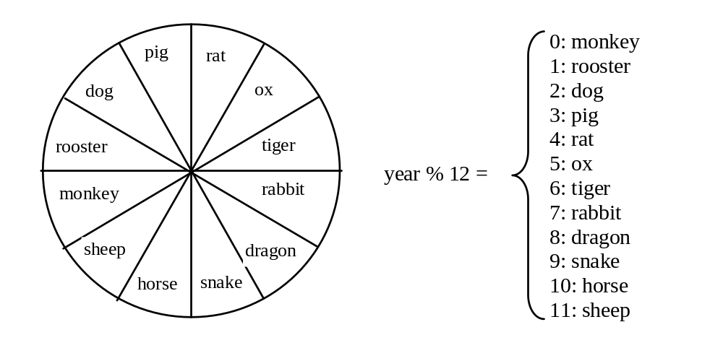
Example
Now let us write a program to find out the Chinese Zodiac sign for a given year. The Chinese Zodiac sign is based on a 12-year cycle, each year being represented by an animal: rat, ox, tiger, rabbit, dragon, snake, horse, sheep, monkey, rooster, dog, and pig, in this cycle.
ChineseZodiac

Slide 23
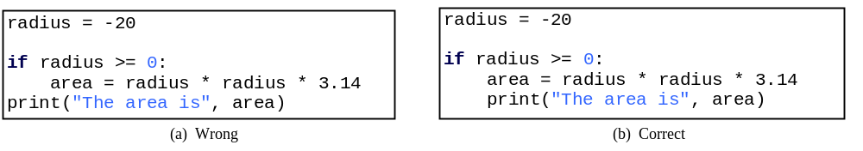
Common Errors
Most common errors in selection statements are caused by incorrect indentation. Consider the following code in (a) and (b).

Slide 24
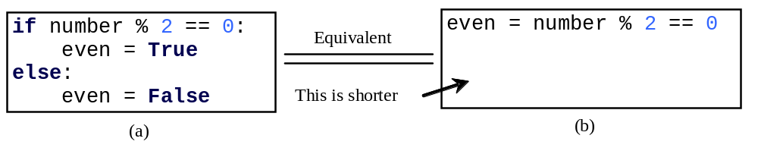
TIP

Slide 25
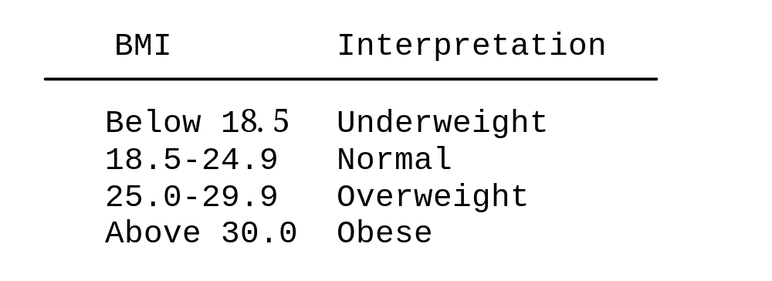
Problem: Body Mass Index
Body Mass Index (BMI) is a measure of health on weight. It can be calculated by taking your weight in kilograms and dividing by the square of your height in meters. The interpretation of BMI for people 16 years or older is as follows:
ComputeBMI

Slide 26
Problem: Computing Taxes
The US federal personal income tax is calculated based on the filing status and taxable income. There are four filing statuses: single filers, married filing jointly, married filing separately, and head of household. The tax rates for 2009 are shown below.
Marginal Tax Rate | Single | Married Filing Jointly or Qualified Widow(er) | Married Filing Separately | Head of Household
10% | $0 – $8,350 | $0 – $16,700 | $0 – $8,350 | $0 – $11,950
15% | $8,351– $33,950 | $16,701 – $67,900 | $8,351 – $33,950 | $11,951 – $45,500
25% | $33,951 – $82,250 | $67,901 – $137,050 | $33,951 – $68,525 | $45,501 – $117,450
28% | $82,251 – $171,550 | $137,051 – $208,850 | $68,525 – $104,425 | $117,451 – $190,200
33% | $171,551 – $372,950 | $208,851 – $372,950 | $104,426 – $186,475 | $190,201 - $372,950
35% | $372,951+ | $372,951+ | $186,476+ | $372,951+

Slide 27
Problem: Computing Taxes, cont.
if status == 0:
# Compute tax for single filers
elif status == 1:
# Compute tax for married filing jointly
elif status == 2:
# Compute tax for married filing separately
elif status == 3:
# Compute tax for head of household
else:
# Display wrong status
ComputeTax

Slide 28
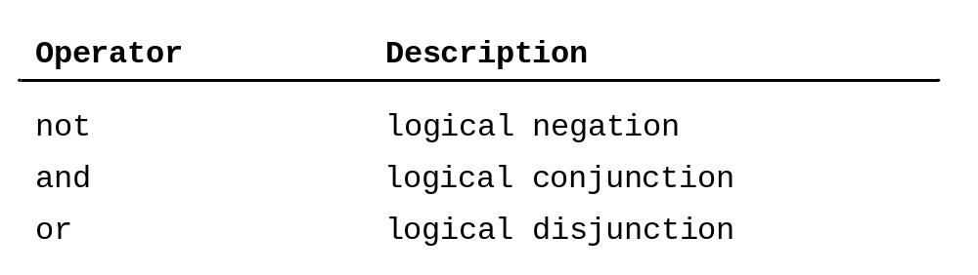
Logical Operators

Slide 29
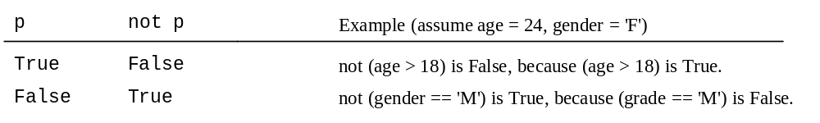
Truth Table for Operator not

Slide 30
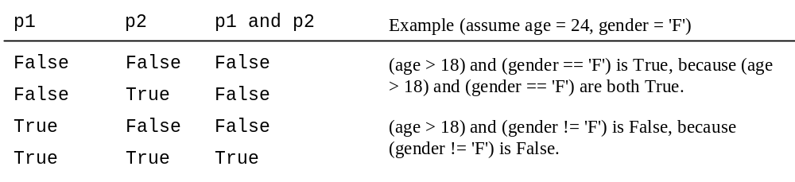
Truth Table for Operator and

Slide 31
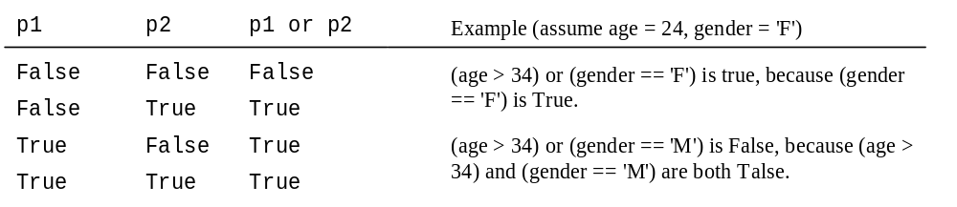
Truth Table for Operator or

Slide 32
Examples
Here is a program that checks whether a number is divisible by 2 and 3, whether a number is divisible by 2 or 3, and whether a number is divisible by 2 or 3 but not both:
TestBooleanOperators
Run

Slide 33
Problem: Determining Leap Year?
This program first prompts the user to enter a year as an int value and checks if it is a leap year.
A year is a leap year if it is divisible by 4 but not by 100, or it is divisible by 400.
(year % 4 == 0 and year % 100 != 0) or (year % 400 == 0)
LeapYear
Run

Slide 34
Problem: Lottery
Write a program that randomly generates a lottery of a two-digit number, prompts the user to enter a two-digit number, and determines whether the user wins according to the following rule:
If the user input matches the lottery in exact order, the award is $10,000.
If the user input matches the lottery, the award is $3,000.
If one digit in the user input matches a digit in the lottery, the award is $1,000.
Lottery

Slide 35
Conditional Operator
if x > 0:
y = 1
else:
y = -1
is equivalent to
y = 1 if x > 0 else -1
expression1 if boolean-expression else expression2

Slide 36
Conditional Operator
if num % 2 == 0:
print(str(num) + “is even”)
else:
print(str(num) + “is odd”);
print("number is even" if (number % 2 == 0) else "number is odd")

Slide 37
Operator Precedence
+, -
**
not
*, /, //, %
+, -
<, <=, >, >=
==, !=
and
or
=, +=, -=, *=, /=, //=, %= (Assignment operator)

Slide 38
Operator Precedence and Associativity
The expression in the parentheses is evaluated first. (Parentheses can be nested, in which case the expression in the inner parentheses is executed first.) When evaluating an expression without parentheses, the operators are applied according to the precedence rule and the associativity rule.
If operators with the same precedence are next to each other, their associativity determines the order of evaluation. All binary operators except assignment operators are left-associative.

Slide 39
Operator Associativity
When two operators with the same precedence are evaluated, the associativity of the operators determines the order of evaluation. All binary operators except assignment operators are left-associative.
a – b + c – d is equivalent to ((a – b) + c) – d
Assignment operators are right-associative. Therefore, the expression
a = b += c = 5 is equivalent to a = (b += (c = 5))

Slide 40
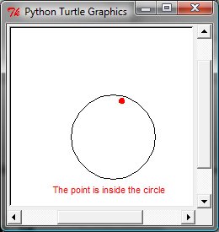
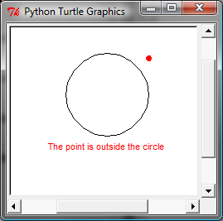
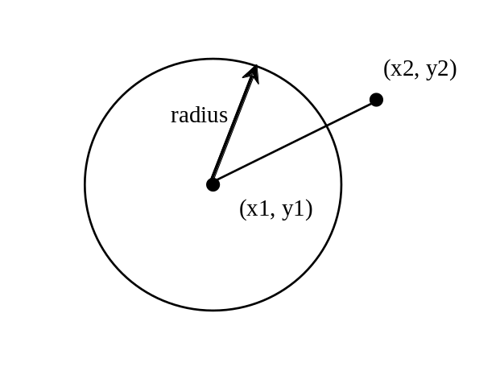
Turtle: Location of an Object
Test whether a point is inside a circle. The program prompts the user to enter the center of a circle, the radius, and a point.
PointInCircle

